Slide 1


Spark and Kafka for Data Analysis and Machine Learning
Cork JUG, 2019-02-19
Johannes Ahlmann
Image: https://softwareengineeringdaily.com/wp-content/uploads/2015/08/kafka-logo-wide.png
https://commons.wikimedia.org/wiki/File:Apache_Spark_logo.svg

Slide 2

About Me
Johannes Ahlmann
sensatus.io
On-Prem AI Models
Gathering and Enriching Web Data
Sales & Client Intelligence
webdata.org
Share Libraries and Best Practices
Bring Data Scientists and SME Companies together
ForDevelopers
AwesomeAvailableDatasets
Contact: johannes@sensatus.io
sensatus.io

Slide 3
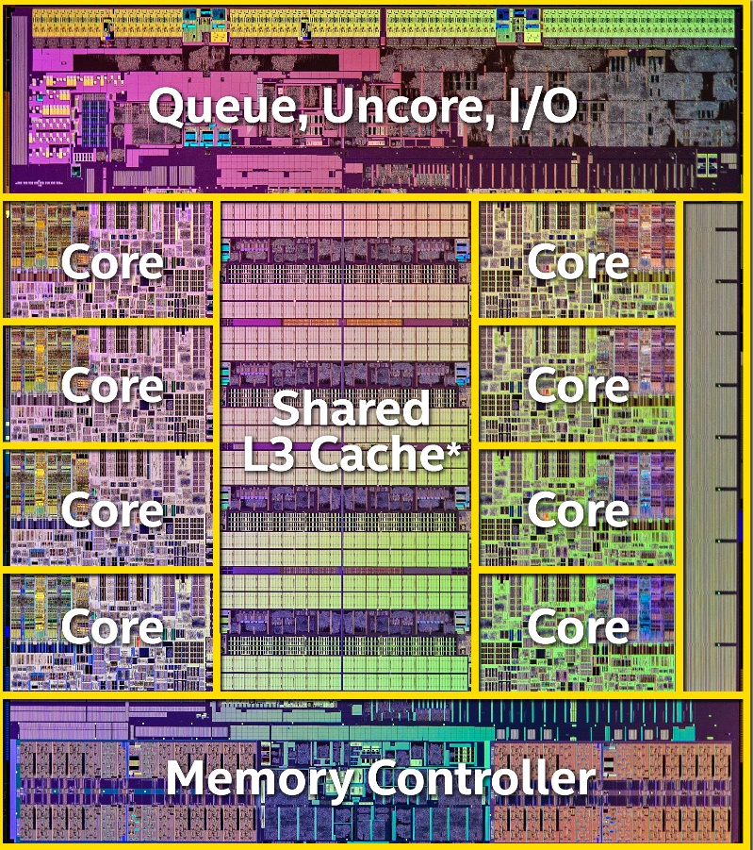
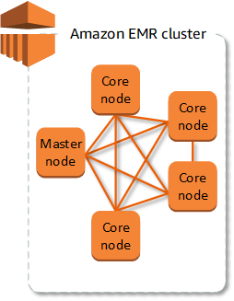
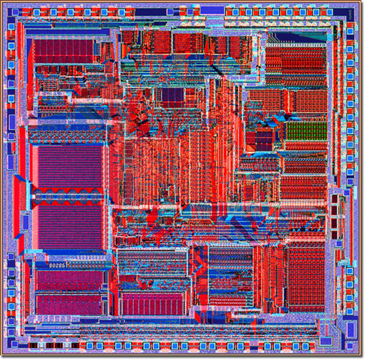
Times Have Changed
Intel 80286 1 core, 0.13M transistors
Intel i7-9900K 8 cores, 3000M transistors

Slide 4
Challenges 1 / 2
Many fantastic libraries written in C, Fortran, Python, Go
How can we leverage libraries together that are written in different languages, or for different (virtual) machines?
Multiprocessing and concurrency are hard in C, Python, etc.
How can we leverage compute of multiple cores per machine, let alone multiple machines
Distributed computing is hard
How can we monitor/ manage/ debug/ reason about it?

Slide 5
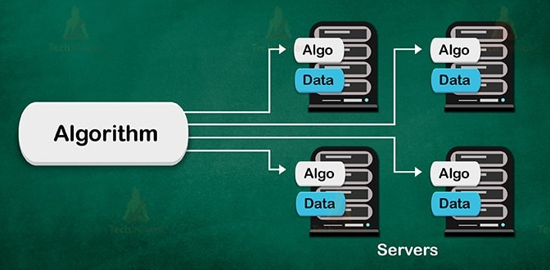
Challenges 2 / 2
Data Locality
Load Balancing
Scaling
State Persistence
Start/ Stop
Error Recovery

Slide 6





JVM Frameworks to the Rescue

Slide 8
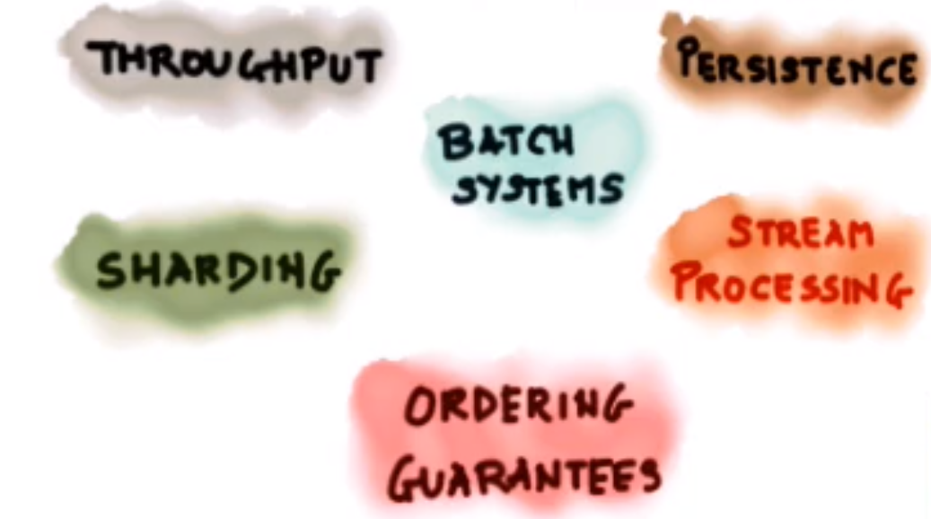
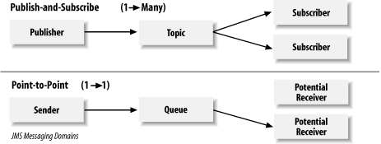
Background: Queues & PubSub
PubSub
multiple subscribers
no scaling
Queues
multiple consumers
single-subscriber
scaling, load balancing

Slide 9
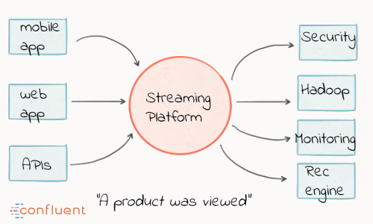
A high-throughput distributed messaging system
Decouples Data Pipelines
Scalable & Fault-Tolerant
Kafka Functionalities
Messaging
Processing
Storing
Performance (>100k/s)
Batching
Zero Copy I/O
Leverages OS Cache
Durability
Image Credit: Confluent

Slide 10
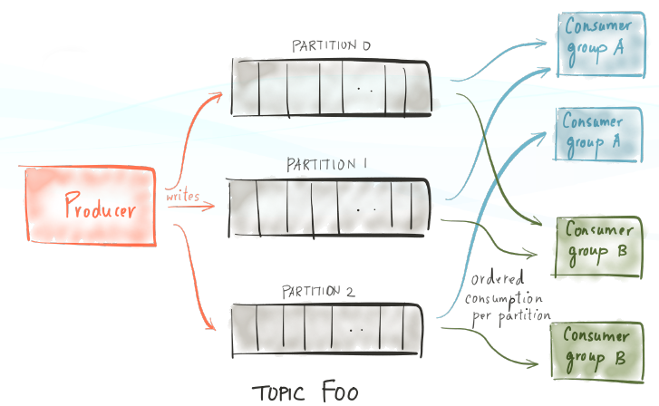
Core Concepts
Producers
Consumers
Brokers
Topics
Zookeeper
Offsets
Broker Addresses
Image Credit: Confluent

Slide 11
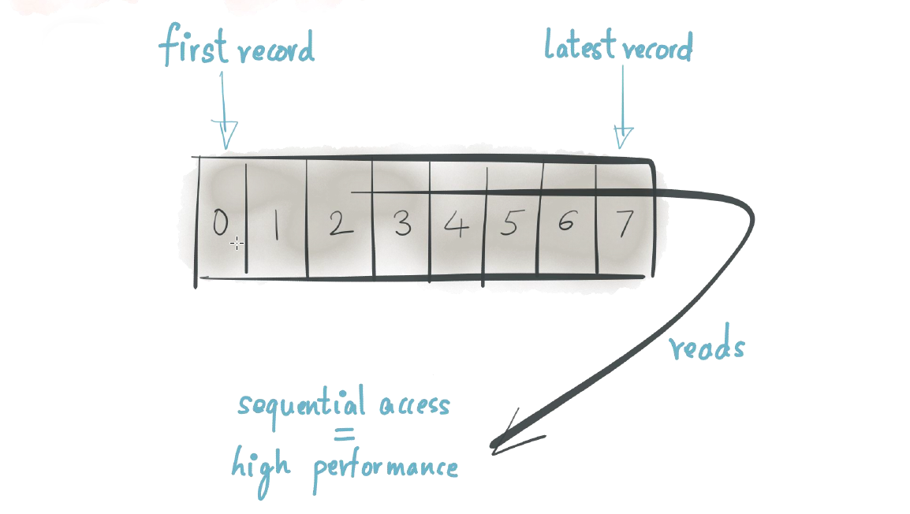
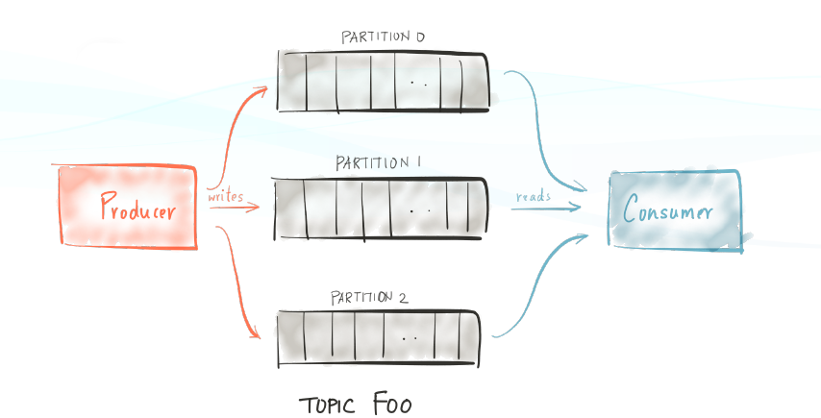
Key Idea: Partitioned Log
Very fast, due to zero copy I/O and batching
Uses sendfile and OS buffer cache
Sequential writes to FS
Order guaranteed within partition
Scaling
Image Credit: Confluent

Slide 12
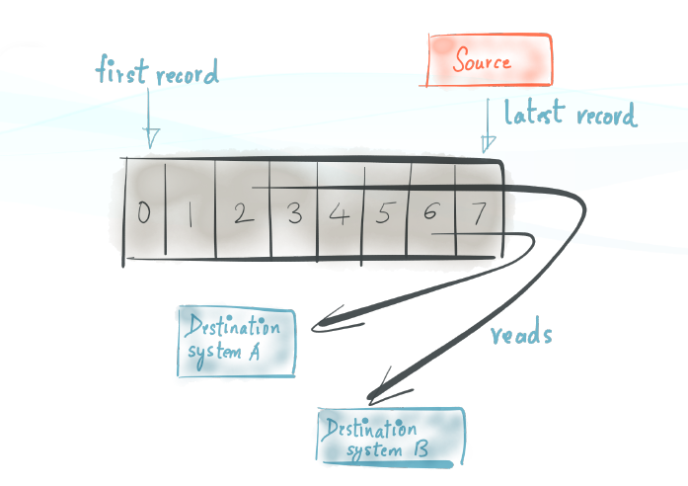
Logs & PubSub
Consumers can be transient
Consumer Groups
Delivery Semantics
at least once (default)
at most once
exactly once
Retention Policy
Reprocessing
Image Credit: Confluent

Slide 13
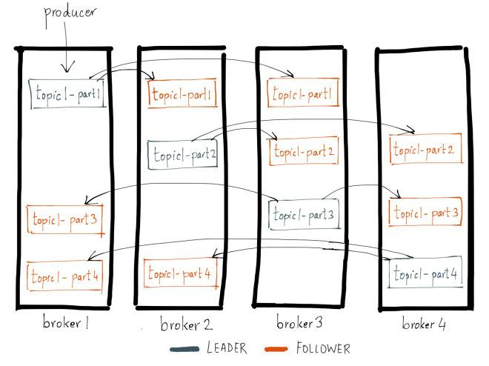
Partitions & Replication
Partitions configurable
Partition allocation
round-robin
semantic partition by key
Replication
optional
1 leader, 0 or more followers
sync or async
flush delay configurable
Image Credit: Confluent

Slide 14
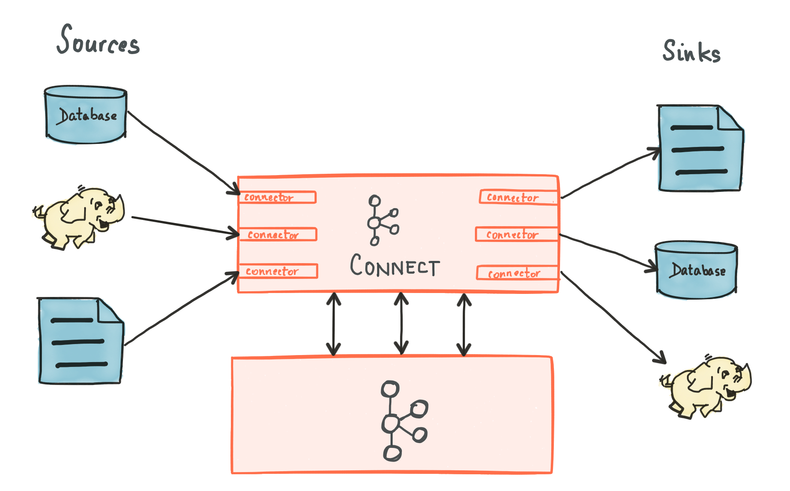
Kafka Connect
Image Credit: Confluent

Slide 15
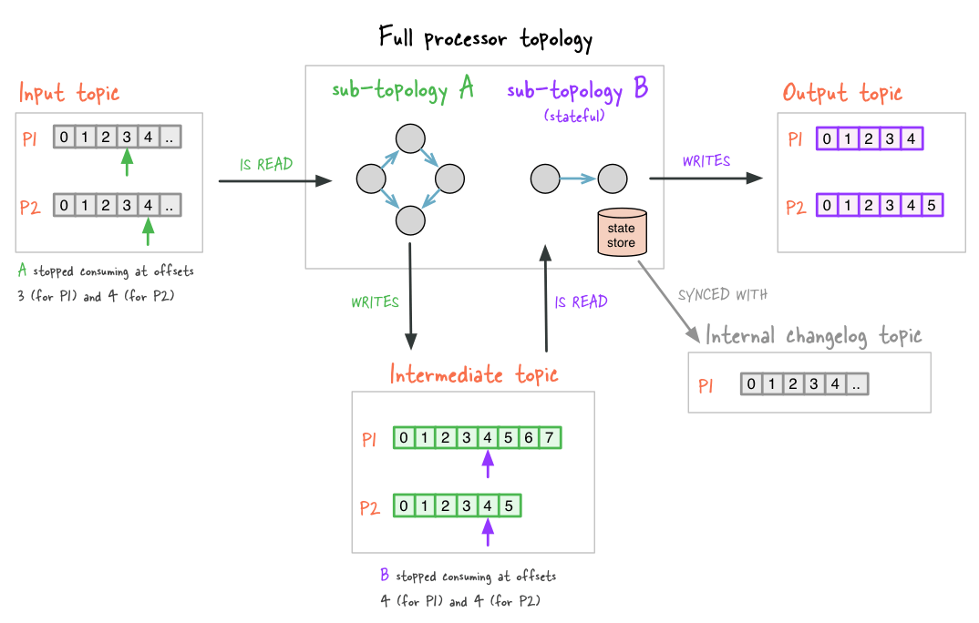
Kafka Streams
Operations
filter
map
join
aggregate
KStream
KTable
manages local state
Windows
stateful
Image Credit: Confluent

Slide 16
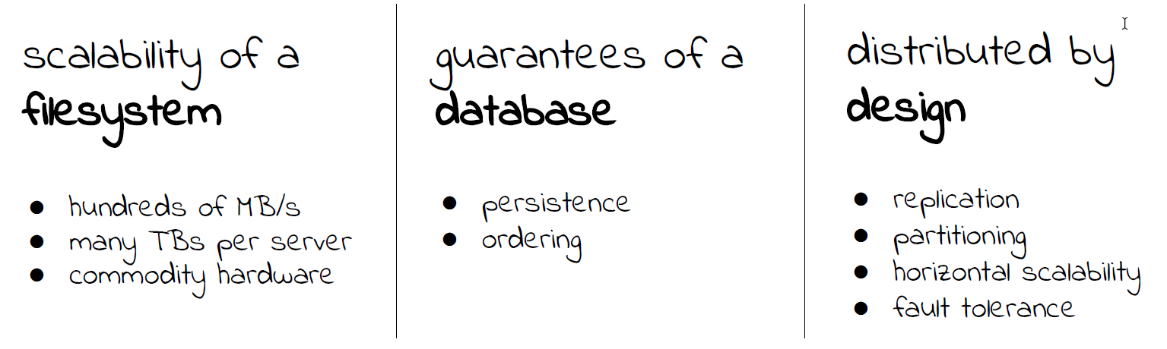
Summary
Image Credit: Confluent

Slide 17


Slide 18

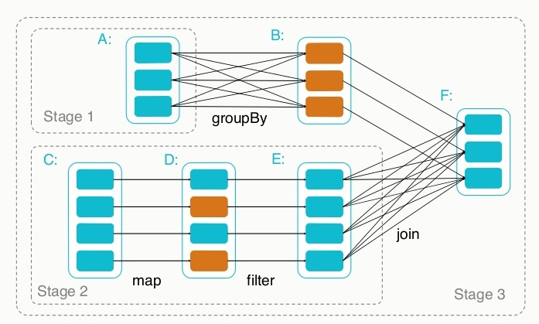
What is Apache
Fast and general engine for large-scale data processing
Multi-stage in-memory primitives
Supports Iterative Algorithms
High-Level Abstractions
Extensible; integrated stack of libraries

Slide 19
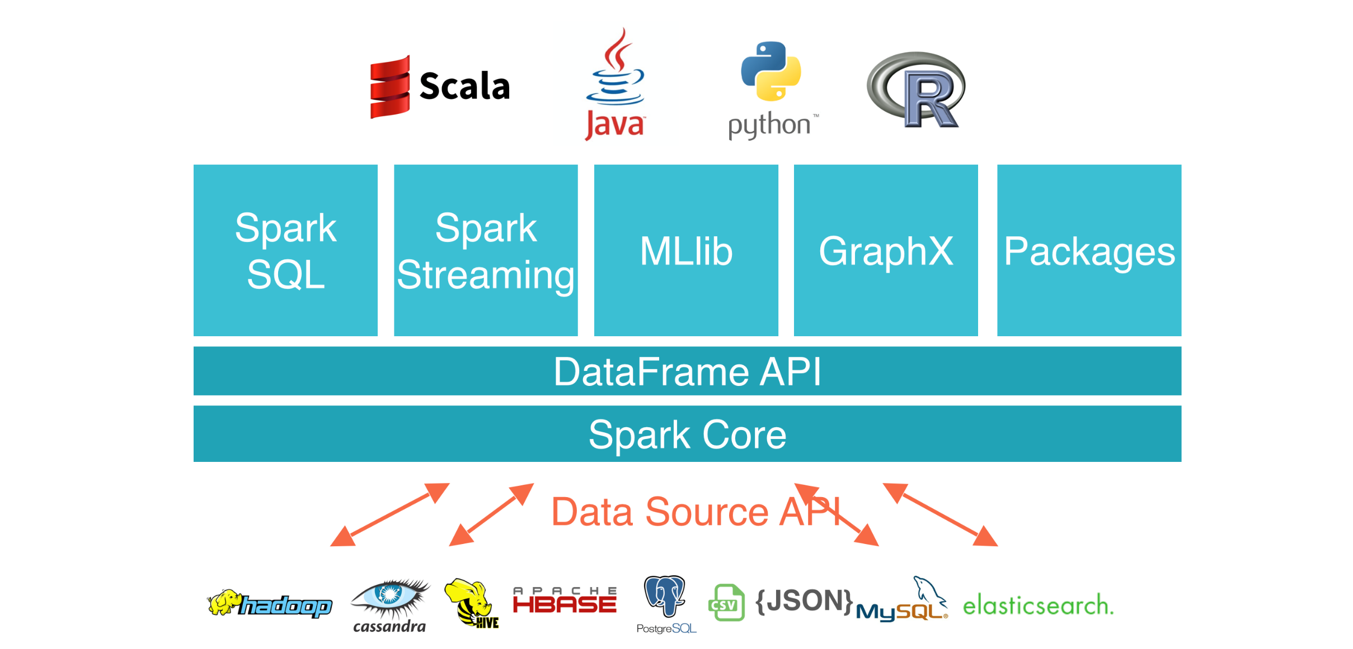
Broad Data, Language Support

Slide 20
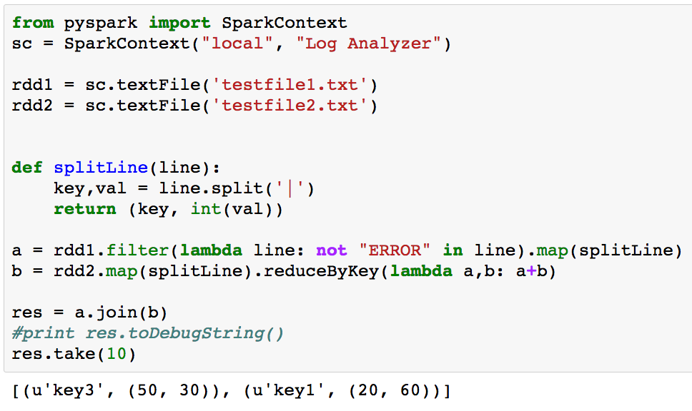
Spark Example

Slide 21
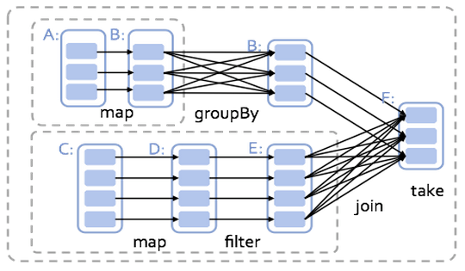
Operator Graph

Slide 22

vs.
Arbitrary operator graph
Lazy eval of lineage graph => optimization
Off-heap use of large memory
Native integration with python

Slide 23
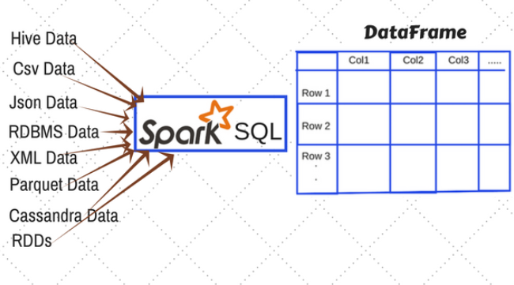
Spark DataFrame
Distributed Collection
Named Columns
Rows, Column, Schema

Slide 24
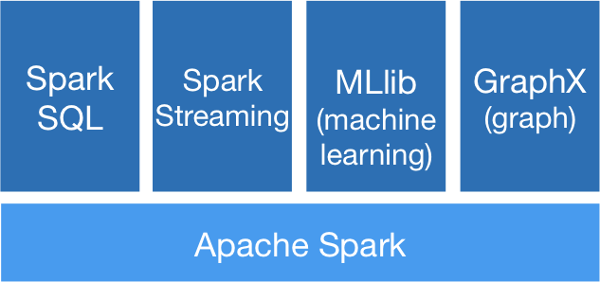
Integrated Libraries

Slide 25
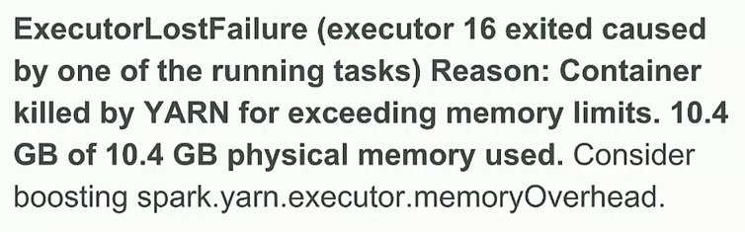
Spark Challenges 1 / 2

Slide 26
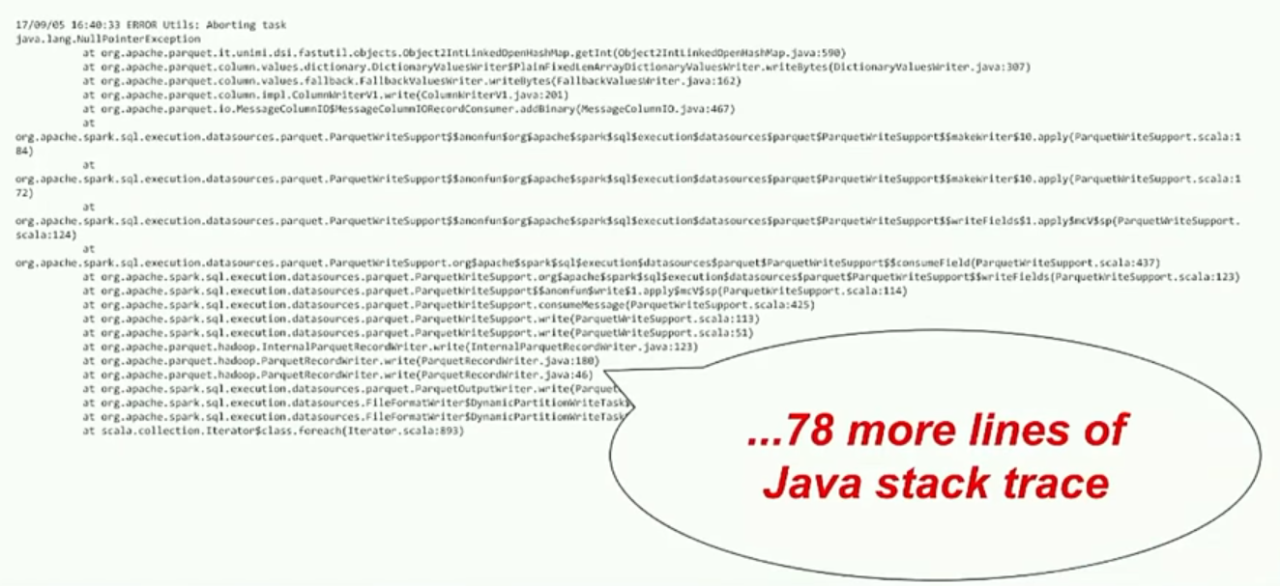
Spark Challenges 2 / 2

Slide 27

Takeaways
Spark...
feels like native python, very nice API
adds awesome Distributed Computing and Parallel Programming capabilities to python
comes with batteries included (SQL, GraphX, MLLib, Streaming, etc.)
can be used from the start for exploratory programming

